Slide 1

Time Series Analysis
Visualize and Analyze energy usage in home

Slide 2
Goal
To evaluate energy consumption for a house, given 3 submeter readings over 3 years.
To forecast energy consumption for future in 3 submeters
To provide the client with energy savings suggestions based on insights that we glean from analysis

Slide 3
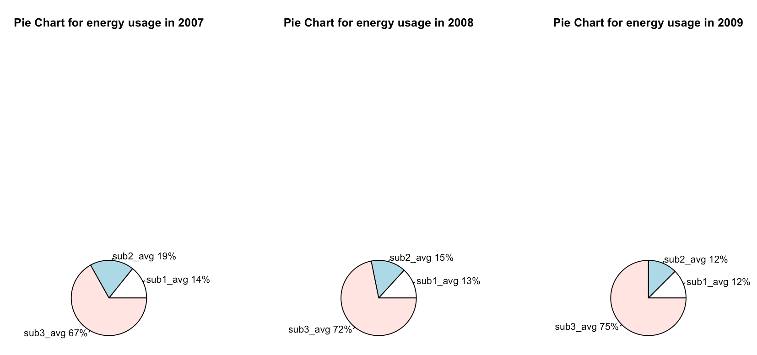
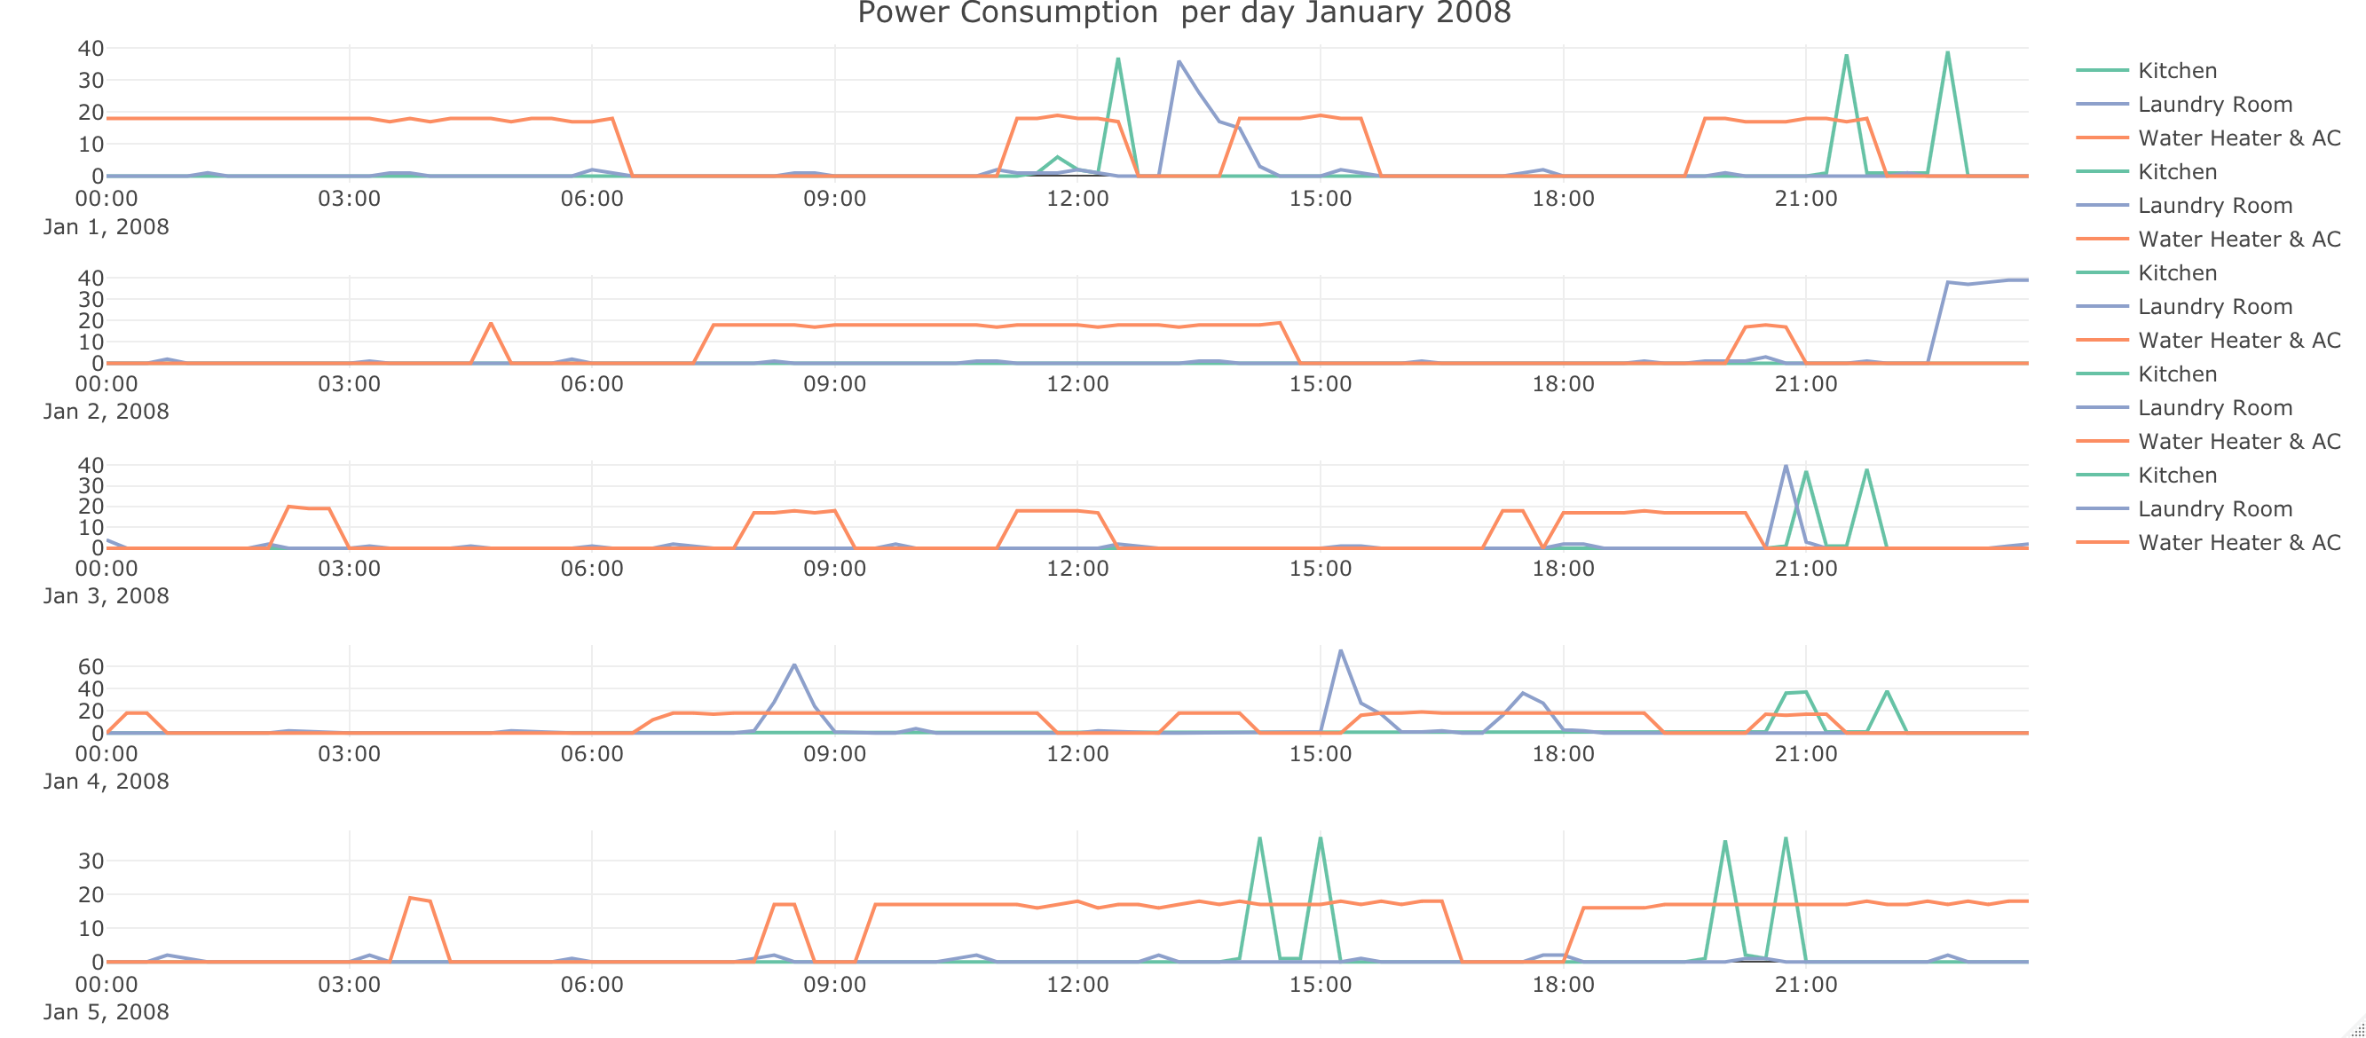
Visualization : Day & week visualization for 3 submeters for home Analysis : 1. Pie Chart shows Submeter 3 uses most power each year since this submeter is wired to AC / water heater for the home which draws maximum usage 2. There is consistent long hours of usage for Submeter 3 , which could be AC / water heater. 3. From weekly chart on right side -> Laundry room energy is being used intermittently , and most energy usage happens (60 kwh) only once a week. 4. Kitchen appliances are being used the least . They are mostly used past 15:00 hrs. for most days in week 1. Fig: Below 5. Energy usage for submeter 3 has increased in 2008, even though there was no usage in summer 2008

Slide 4

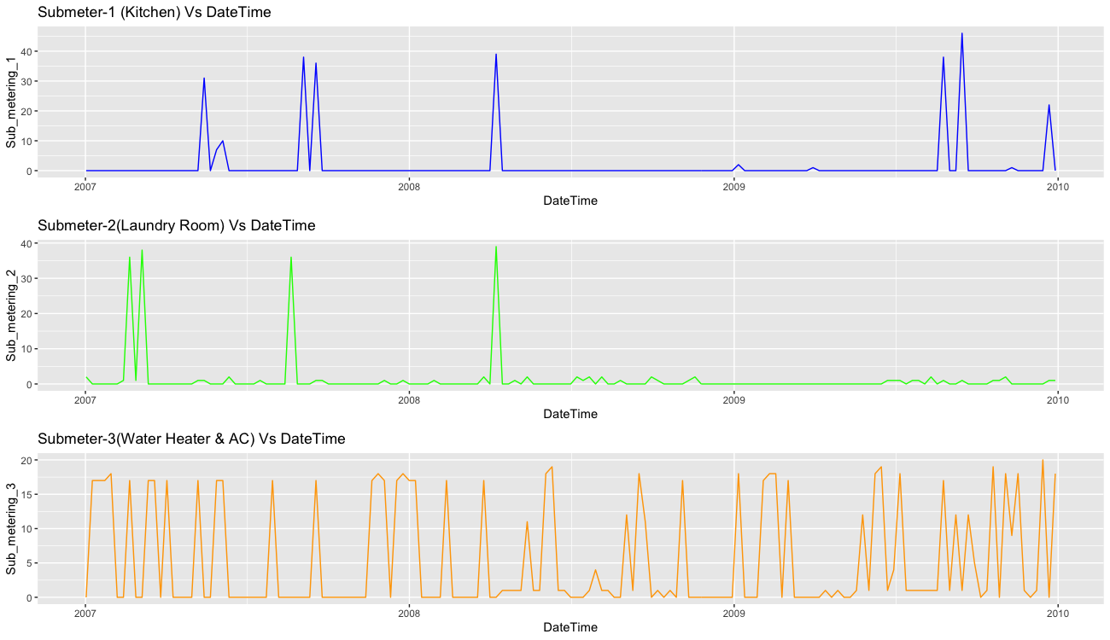
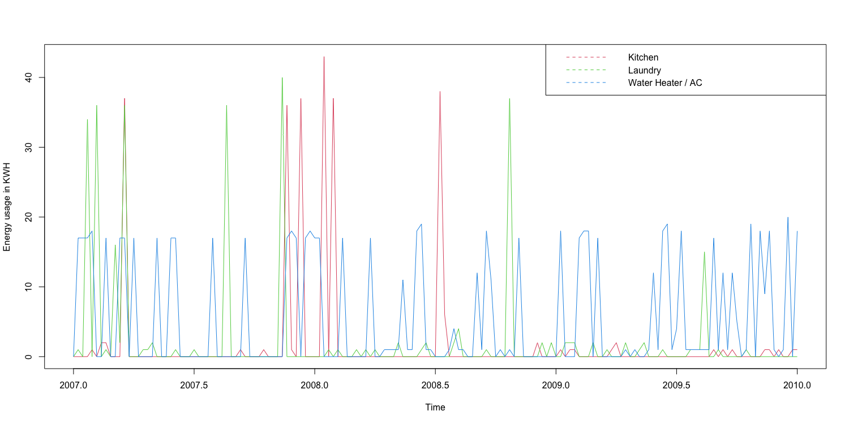
Time Series Visualization
Granularity 1 : Created subset with frequency = 52 energy reading taken every Monday at 8pm for the year 2007, 2008 & 2009
Granularity 2 : Created subset with frequency = 48 energy reading taken every 30 minutes, 1st week in January 2008
In all subsequent visualizations and analysis Granularity 1 is used, since it yielded better results compared to 2.
Fig: 1 -> Created subset with frequency = 52, taking energy reading every Monday at 8pm for the year 2007, 2008 & 2009
Fig: 2 -> Monday 9pm. Submeter 3 draws more usage
There is a spike in Kitchen usage in 2008. Further investigation needed as to why.

Slide 5
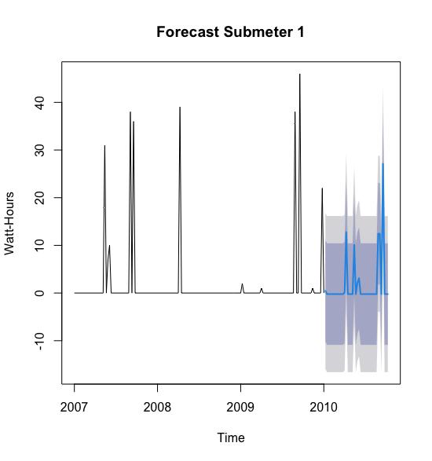
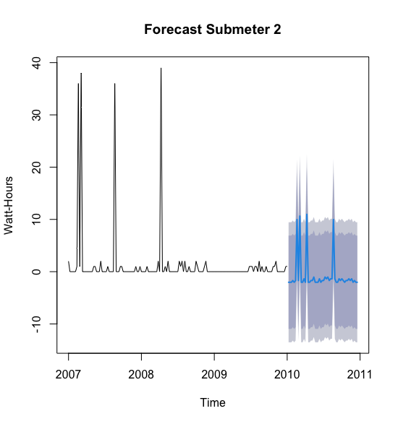
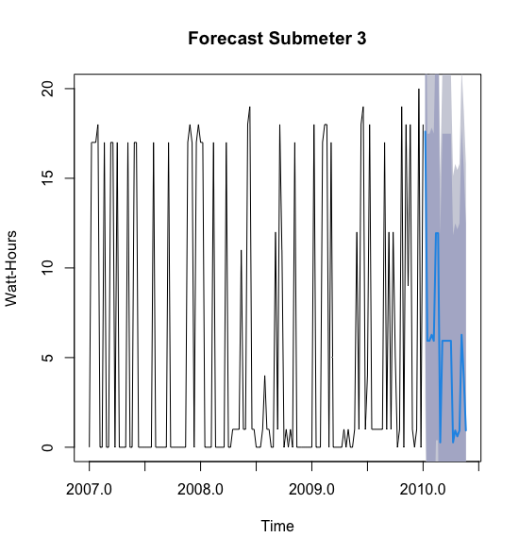
Time Series Model – Visualization and Analysis
Applied time series linear regression to all sub-meters to obtain RMSE for each forecast.
Forecasted 20 periods ahead with confidence levels 80 and 90.
Timeseries model did capture the pattern , but negative readings could point to white noise .
Further analysis to be done using Holt Winters model to understand trend
Submeter | RMSE
1 | 7.054
2 | 5.911
3 | 7.648

Slide 6
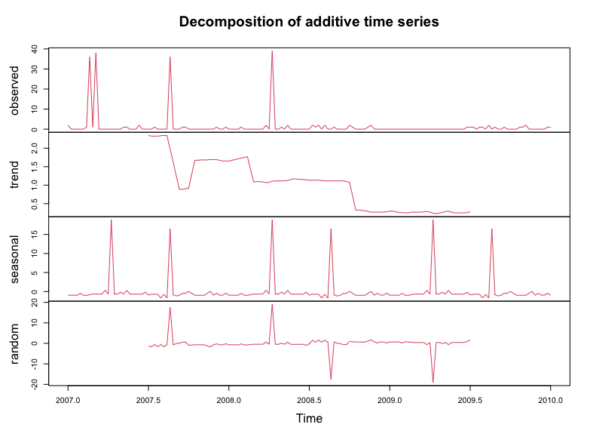
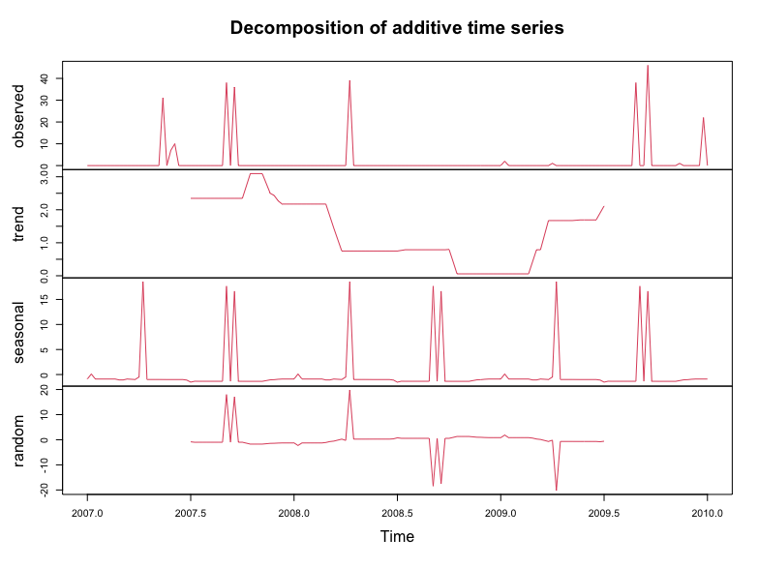
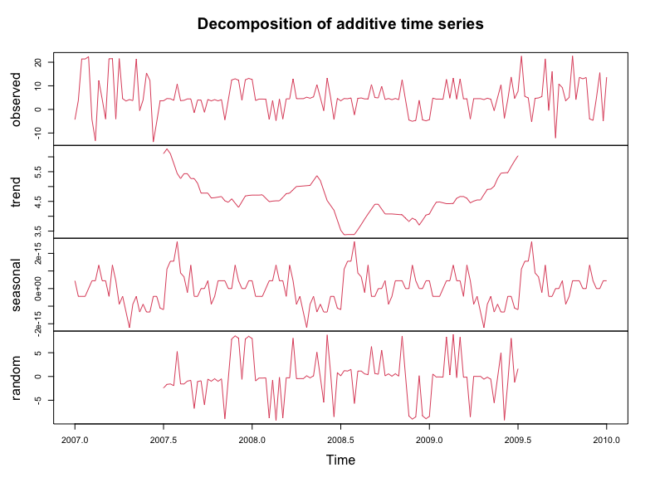
Decomposition of Time series Data
All submeters have seasonal and trend component to them.
Submeters 2 & 3 have a higher usage in the summer of 2007 and summer of 2009 ( with exception of Submeter 1 which flatlines )
Usage reduces drastically in summer of 2008 maybe indicating the home was not occupied for some period .

Slide 7
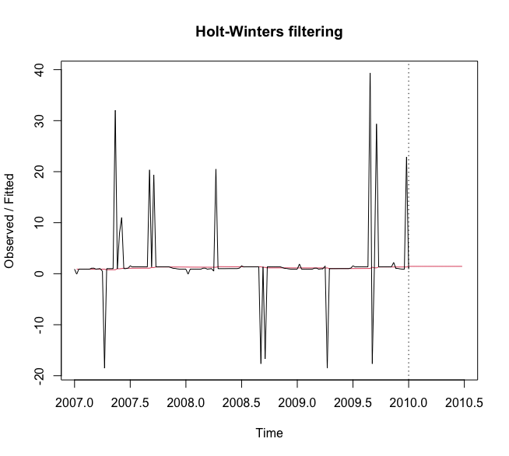
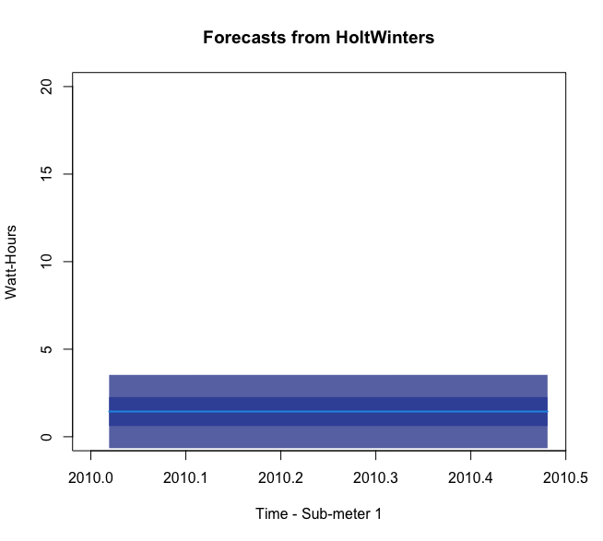
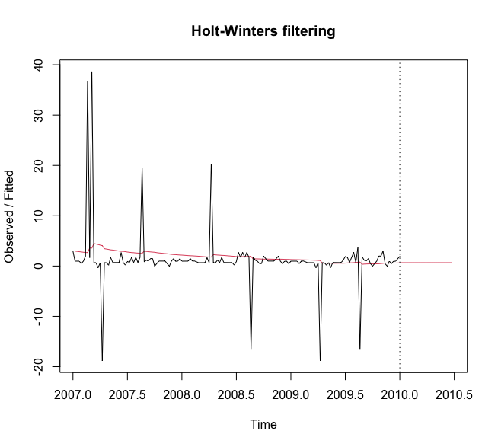
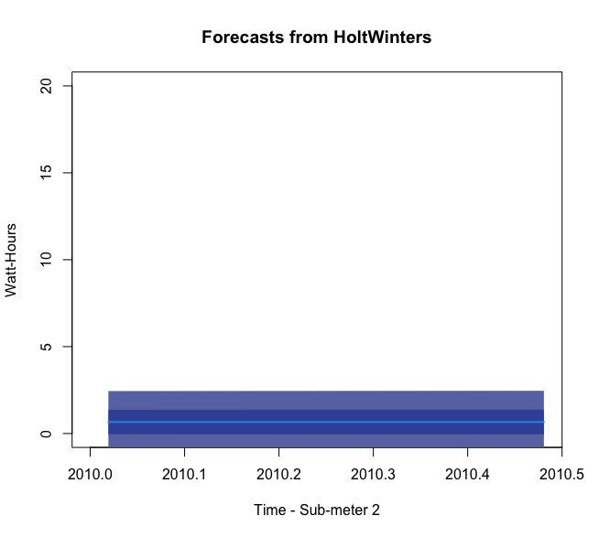
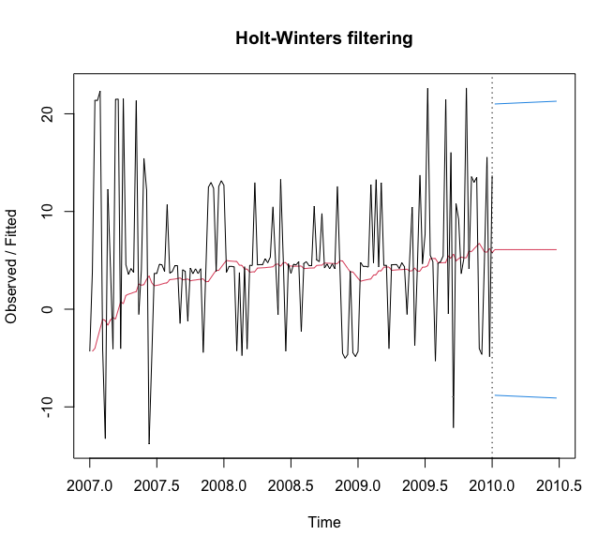
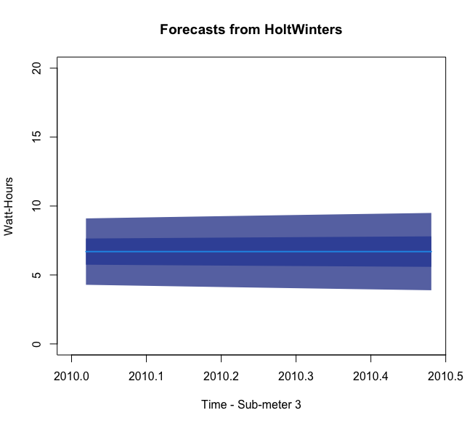
Holt Winters Forecasting
Removed seasonal component to identify trend in usage.
TSLM model discussed previously predicted a linear relationship without considering the components in data. Hence the predictions may not be very reliable and may cause overfitting .
Holt Winters predictions are constant for future date with diminished confident interval of 10% and 25%
Since Trend and Seasonal components are FALSE the forecast is constant .
There is some negative prediction in Submeter 3 contributed by white noise .

Slide 8

Summary
Holt winters model has successfully predicted future energy usage with the data provided.
Submeter 3 uses most power each year since this submeter is wired to AC / water heater for the home which draws maximum usage.
Energy usage for submeter 3 has increased in 2008 by 5%, even though there was no usage in summer 2008. Further evaluation needed on this
Energy usage in Submeter 2 was higher by 4% in 2007 , but has decreased subsequent years
Submeter 1 usage also has reduced since 2007 for subsequent years.
Further analysis on this might throw some insight on energy conservation in the future
There is a spike in Kitchen (Submeter 1) usage in 2008. Further investigation needed as to why.

Slide 9
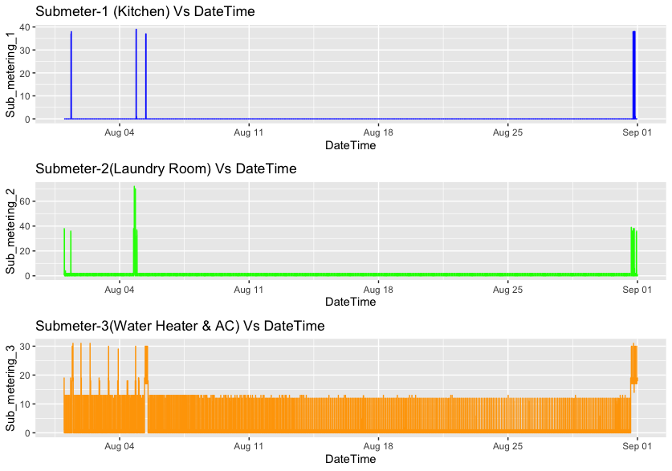
Suggestions
Separate devices connected to Submeter 3 ( AC & Water heater) which draws maximum usage every year and to draw clear understanding of which is used more.
Evaluate further usage patterns on submeters 1 & 2, whose average usage has reduced for 2 years in a row. This will provide us insight on how to consistently keep energy usage down for submeter 3 and the entire house.
As per Line plot on right -> Invest in equipment to moderate AC usage when no one is home. The visualizations for summer of 2008 show Submeter 3 usage as normal, whereas all others have zero usage, which could be indicating that the house may have been empty.

